Slide 1
ANR & the European Research Framework Programmes
Perspectives on Horizon Europe and
French-Lithuanian cooperation
20/10/2021

Slide 2
I / Who we are

Slide 3
ANR – A project funding agency
Public organisation - Created in 2005- Under the French Ministry of research and higher education (MESRI)
5 missions
- To fund and promote the development of basic and applied research, technological innovation, technology transfer and public-private partnerships
- To implement the Action Plan approved by the French Ministry of Research
To manage major government investment programmes in the fields of higher education and research
To strengthen scientific cooperation across Europe and worldwide
- To analyse trends in research offering and assess the impact of the funding it allocates (added 2014)

Slide 4
A wide remit
all fields of science and all types of research (basic, applied, experimental)
Public or private funding recipients: universities, research organisations, foundations, commercial companies...
Various instruments described in a yearly Action Plan (https://anr.fr/fr/pa2022/)
Annual activity report https://anr.fr/en/anrs-role-in-research/the-agency/documents/

Slide 5
Our action cycle
Programme definition
(scientific priorities, instruments,
International cooperation)
Ex-post evaluation
(outputs, outcomes
impact)
Selection
(calls for proposals,
evaluation)
ANR
Project implementation
(funding contracts,
project monitoring)
Notes:
In blue dimensions that we try to emphasize

Slide 6
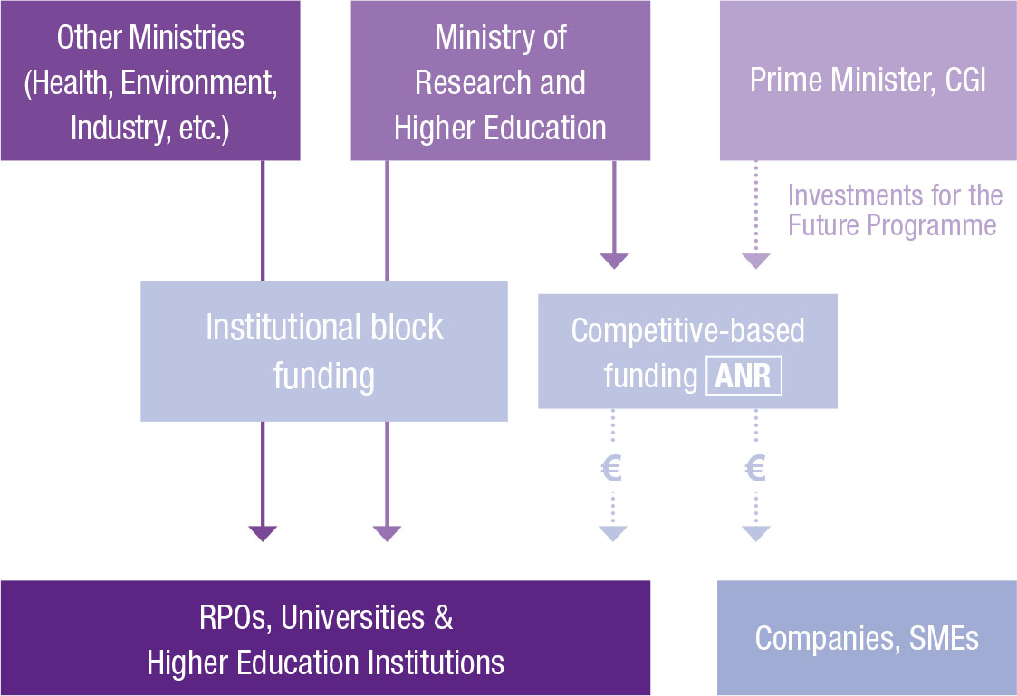
ANR in its national institutional environnement

Slide 7
ANR in its extended ecosystem
Notes:
Interacting with a galaxy of international actors and one of the several French actors on the international scene, especially at the European level

Slide 8
ANR and other funding sources
Funding range
(whole project duration)
€10 M
Horizon 2020
ERC
€1 M
ANR
BPI France
€0.1 M
Basic
Research
Industrial Exploratory Research
Innovation
Development
Notes:
ERC : 10M * 6 years so on a comparable duration (4 years) around 6,5M€ max.

Slide 9
Our commitments…
To act in the service of science
To guarantee the quality, efficiency and transparency of our processes
To contribute to the evolution of science culture

Slide 10
…and their enactments
Scientific integrity
Ethics charter
San Fransisco Declaration on Research Assessement (DORA)
Quality
ISO 9001 certification
Gender equality
Action plan
Open science
National plan « Open science » (France) and Plan S (Europe)
Data Management Plan (mandatory)
Fair science
Nagoya protocol
Citizen science
CSTI (Scientific, technological and industrial culture)

Slide 11
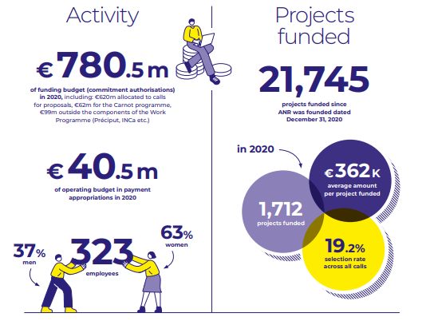
Key figures 2020

Slide 12
II / International activity

Slide 13
Participation in policy fora
Member of
Science Europe
GRC (Global research council)
G7 research
Coalition S

Slide 14
A diversified portfolio of internationally oriented funding schemes
1 / Transnational calls for research proposals
PRCI instrument
Ad hoc transnational calls
Bilateral calls
Multilateral calls
2 / Schemes directed at fostering and increasing French participation in European schemes, in keeping with the "National Action Plan to improve French participation in the European research and innovation funding schemes" (PAPFE):
“Establishing European or International Scientific Networks” (MRSEI)
“Springboard-ERC” (T-ERC)
"Access-ERC" (new)
3/ Schemes in support of other French organisations
Example : PEA (Partnership with African Higher education institutions) funded by AFD (French research development agency)
Notes:
3/ = not related to EU programmes so will not be developped here

Slide 15
1/ Transnational calls for proposals
Notes:
281 transnational projects funded in 2020 – 13% - 81M€
36% though the bilateral lane of the « Generic call » (PRCI) – 12% through ad hoc bilateral calls – and 52% through multilateral calls

Slide 16
A strong commitment to building the ERA
Role of ANR: represent French research communities in various European initiatives and allow them to participate
Joint Programming Initiatives (JPI)
Participation in the 10 existing JPIs and role in the governance structures of 8
JPI Water: coordination and secretariat + Chairing by an ANR staff ; JPI FACCE: vice-chairing by an ANR staff
European funded P2Ps
Since 2006 (PCRD 7 and H2020) : participation in 88 European contracts (ERA-Net, ERA-Net +, ERA-Net Cofund, EJP, CSA, Art. 185…)
In H2020 : coordination of 13 ERA-Net Cofund and 1 CSA
Notes:
ANR = one of several French actors involved in the EFP (ex: other funders like ADEME) – sometimes not the only French actor or even funder in a given P2P

Slide 17
ANR’s main partner countries

Slide 18
Share of transnational cofunded projects 2006-2020

Slide 19
Nevertheless, a great diversity of partner countries
71 partner countries in total since 2006
3 times more funders* => Very diverse opportunities offered
* (some of which international: directly supporting teams from 3rd countries)

Slide 20
Our priorities
Regional and/or thematic
Set by our stakeholders (Ministries, Alliances, RPOs) in a flexible way
As part of our regional priorities:
- European research area (ERA) ;
- Euro-Mediterranean and Euro-African partnerships
- Partnerships with established major research countries (US, Canada, Japan...) ;
- Partnerships with other major countries (China, India, Russia, Brasil...).
Notes:
National plans 2020 (targeted funds): AI, SSH, RD, AMR, autism in neurodevelopmental disorders
2021: the same except AMR, replaced by bioproduction of medication. AMR still a priotity at the national level (INSERM plan) + internationally for ANR with the European Partnership OH-AMR

Slide 21
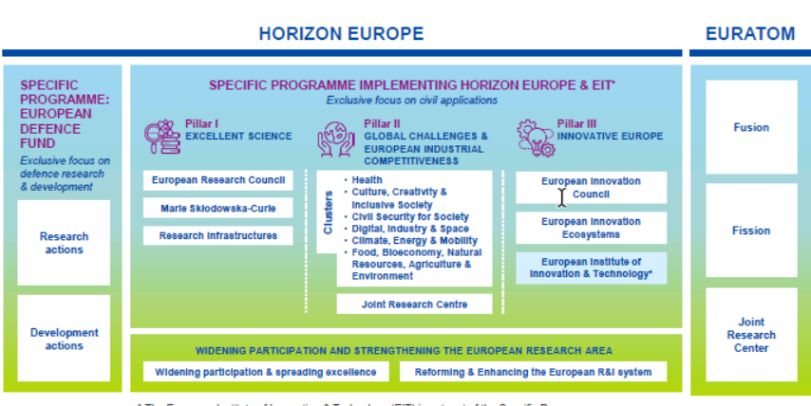
Horizon Europe : towards the « Partnerships »

Slide 22
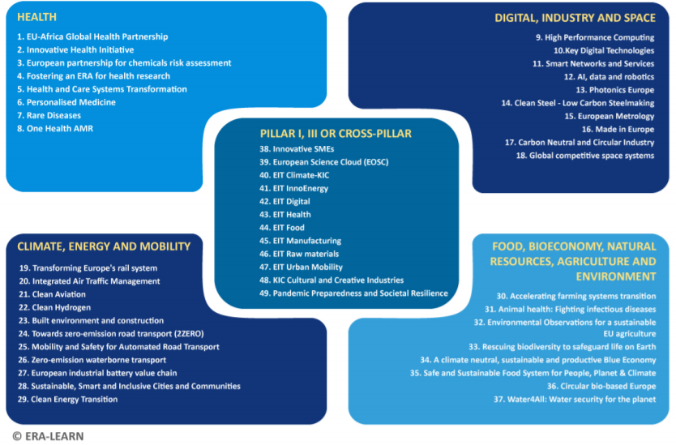
?
?
?
?
?
Notes:
One Health-AMR, Rare Diseases, ERA4HEALTH, PERMED, Biodiversa+, Water4all, Blue economy, CET (Clean energy transition), DUT (Driving urban transitions), Health & care systems transformation… + KDT*, HPC*

Slide 23
Starting end of 2021 : first call open 7th of October (Biodiversa+)
participation in about 12 1st wave Partnerships
1 call per year for 6 years
Several 2nd wave Partnerships under consideration - cf preparatory CSAs (H2020 like EBRA or HE: GreenERAHub, Design OH-AMR, etc.)

Slide 24
2 / Schemes directed at improving French participation in European programmes

Slide 25
Establishing European or International Scientific Networks (MRSEI)
Created: 2015
Objective: aims to strengthen the position and outreach of French research on the European and international scene by helping to prepare a proposal to a call, coordinated by a French partner.
Eligibility: Research & knowledge organisations (companies not eligible) – A single Fr. PI
A call must be identified in the proposal. Target calls include ERC Synergy, MSCA, EIC…
Networking costs => Fr. PI funds involvement of foreign future partners
2 to 3 deadlines per year
Duration: 24 months
Maximum grant: 30K€

Slide 26
Springboard-ERC
Created: 2016
Objective: reinforce the success of French researchers for the “Starting grants” and “Consolidator grants” calls for proposals of the European Research Council (ERC)
Eligibility/selection: A graded applicants from the previous ERC session (French R&K organisations)
Target: resubmission to Starting and Consolidator ERC grants
Duration: 24 months
Maximum grant: 100K€

Slide 27
Access-ERC
Creation: 2022 (pilot in SSH)
Objective: host young post-doctoral researchers who are seeking to boost their international visibility and submit a future application to an ERC programme, in particular Starting grants and Consolidator grants.
Eligibility: PhDs (French or foreign) who have defended their doctorate less than three years ago
Target/requirement: application to an ERC Starting (or Consolidator) grant
Selection: application file + oral examination
Duration: 24 months
Maximum grant: yet to be defined. Salary will be included.

Slide 28
III/ Focus on French-Lithuanian cooperation through ANR funding
12 cofunded projects (in 12 different calls)
Joint participation in 33 European P2P partnerships across FP7 and 8
Joint membership of 4 JPIs
=> Many more joint calls launched together (circa 45)
Notes:
a small number of cofunded projects : but comparison with Latvia (19), Estonia (17) shows no spectacular difference. And in relation to population it is twice more than Poland for instance

Slide 29
Example of cofunded project
Project MILEDI
Multiscale Modelling of Impaired LEarning in Alzheimer’s Disease and Innovative Treatments
FLAG-ERA 2019 – HBP (Human Brain Project flagship)
LT-FR-IT (funded by LMT-ANR-MIUR)
Coordinated by Ausra SAUDARGIENE Lithuanian University of Health Sciences
With Hélène MARIE Institute of molecular and cellular pharmacology (CNRS, Nice)
And Michele MIGLIORE, Institute of Biophysics, CNR, Palermo)
Objective : develop a new multi-scale (integrated molecular, cellular and network levels) data-driven in silico model of the hippocampal CA1 region under Alzheimer's disease conditions
- Fr Partner in charge of electrophysiology recordings
- Lithuanian and Italian partners in charge of computational modelling

Slide 30
Thank you for your attention https://anr.fr pierre-olivier.pin@anr.fr

